Slide 1
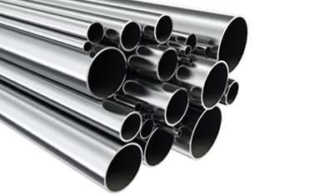

Pipe Inventory Management System

Slide 2
Project Leadership
Under the Guidance of
Ranjitha Padakanthi
Team Lead
Innodatatics
Savyasachi R
Team member
Innodatatics

Slide 3

Contents
Followed By CRISP-ML(Q)
Business Problem
Business objective
Business Constraints
Project Architecture
Data collection and details
Exploratory Data Analysis
Visualization
Modeling
Evaluation
Deployment
Notes:
Change

Slide 4

Business Problem
Counting manually and keeping track of the number of steel pipes of different dimensions and shapes is cumbersome process

Slide 5

Business Objective & Constraints
Objective
Minimize the time taken for Counting the Pipes
Constraints
Minimize the operational Cost

Slide 6
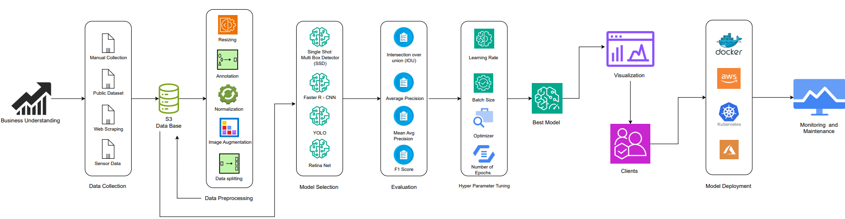
Project Overview and Scope

Slide 7
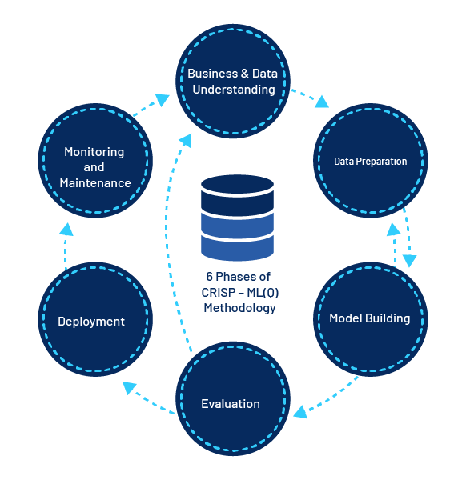
CRISP-ML(Q) Methodology
There are six stages of CRISP-ML(Q) Methodology
1.Business and data understanding
2.Data preparation
3.model building
4.Model evaluation
5.Model deployment
6.Monitoring and maintenance

Slide 8







Technical Stacks
Tools and Technologies used to build a pipe inventory management system are:

Slide 9
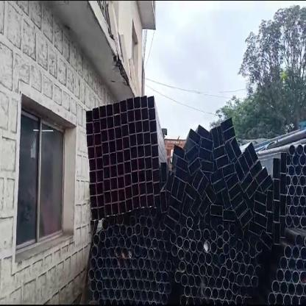
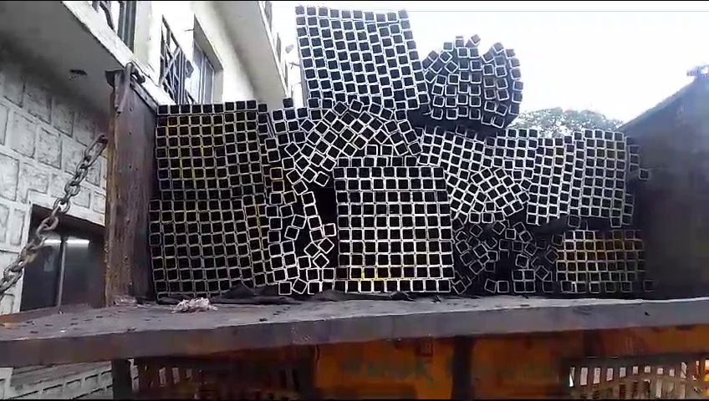
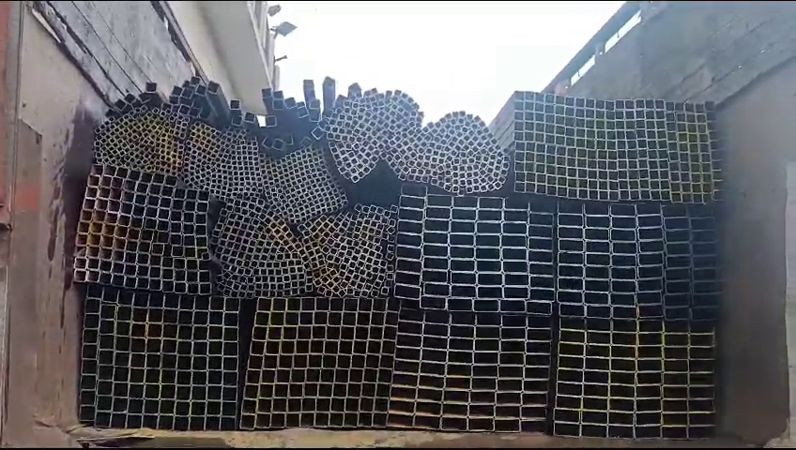
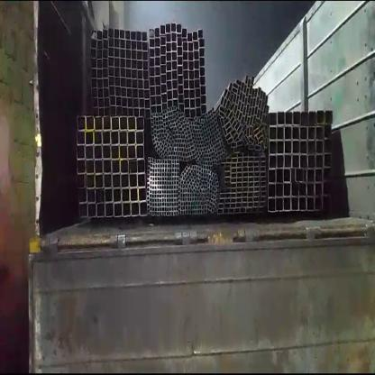
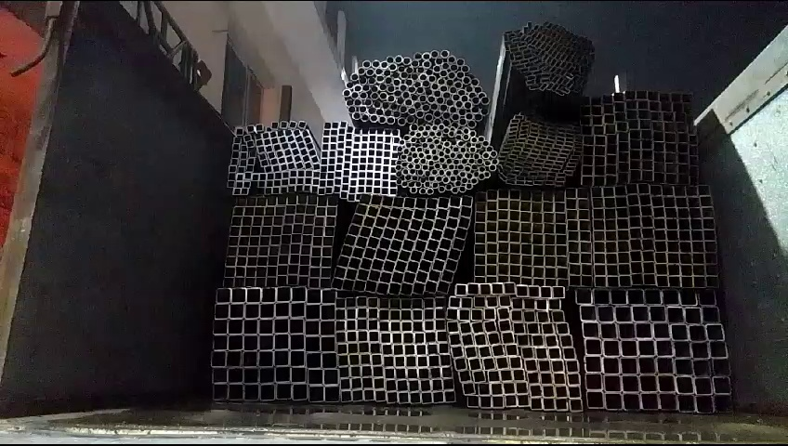
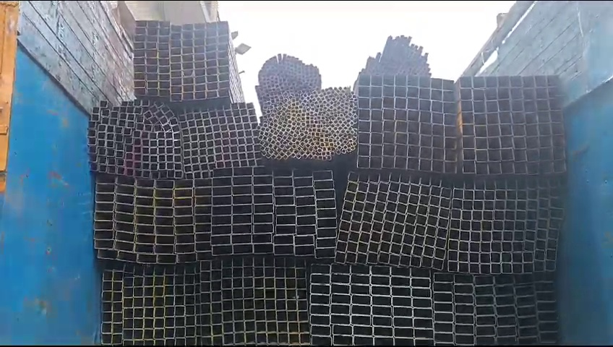
Data Collection and Understanding

Slide 10

Data Information
Data in Image format
Image Contain Multiple Objects to Count
Different images have different Objects to Detect

Slide 11
Exploratory Data Analysis [EDA]
Dataset Size: 712 images
Data split: Train = 1815, Valid = 61, Test = 46
Annotation: 3,86,887 and 530 Annotation per images (avg)
Classes: “C 32 2.5” , “C 38 2.9” , “R 20 40 1.9” , “R 25 75 1.9” , “R 48 96 2.0” , “R 48 96 2.9” , “R 60 40 1.9” , “R 80 40 1.2” , “S 20 20 1.2” , “S 20 20 1.9” , “S 25 25 1.9” , “S 25 25 2.5” , “S 38 38 1.9” , “S 40 40 2.5” , “S 50 50 1.5” , “S 50 50 1.9” , “S 50 50 4.0” , “S 60 60 2.0” , “S 72 72 4.0” , “S 72 72 4.8”
Notes:
EDA is used for seeing what the data can tell us before the modeling task.
Change

Slide 12



Model Building
Models Used:
YOLOV8 L
YOLOV8 S
YOLOV5 L
YOLOV5 S
YOLO NAS
DETR
MM Detection
Notes:
classification is the task of predicting a discrete class label. Regression is the task of predicting a continuous quantity.
What is classification techniques in machine learning?
The Classification algorithm is a Supervised Learning technique that is used to identify the category of new observations on the basis of training data. In Classification, a program learns from the given dataset or observations and then classifies new observation into several classes or groups.
What is regression techniques in machine learning?
Regression is a technique for investigating the relationship between independent variables or features and a dependent variable or outcome. It's used as a method for predictive modeling in machine learning, in which an algorithm is used to predict continuous outcomes.

Slide 13
Model Accuracy Comparison
Model | Version | Data Size | Image Size | Epoch | mAP 50 | mAP 50-90
YOLO V8 L | V1 | 81 | 250 | 10 | 0.039 | 0.0174
 | V2 | 247 | 250 | 10 | 0.0033 | 0.0085
YOLO V8 S | V1 | 81 | 416 | 10 | 0.00064 | 0.00204
 | V2 | 247 | 200 | 10 | 0.0020 | 0.0045
YOLO NAS | V1 | 81 | 28 | 5
 | V2 | 247 | 28 | 5
DETR | V2 | 247 | 100 | 50 | 0.005 | 0.001
MM Detection | V1 | 81 | 1 | 1 | 0 | 0

Slide 14
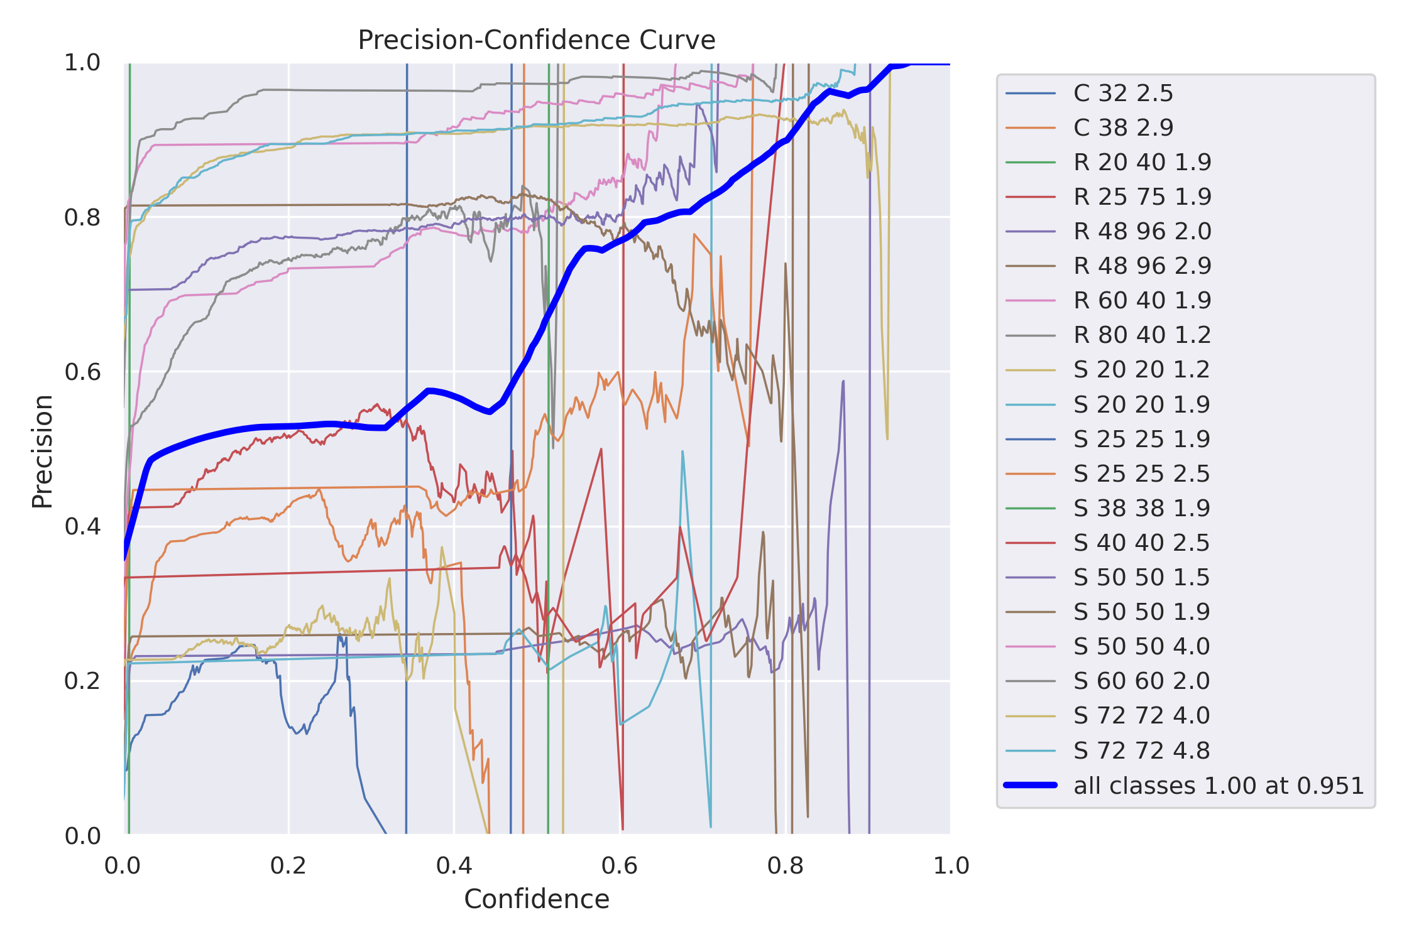
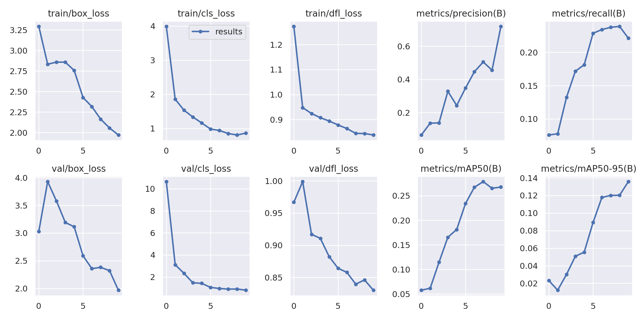
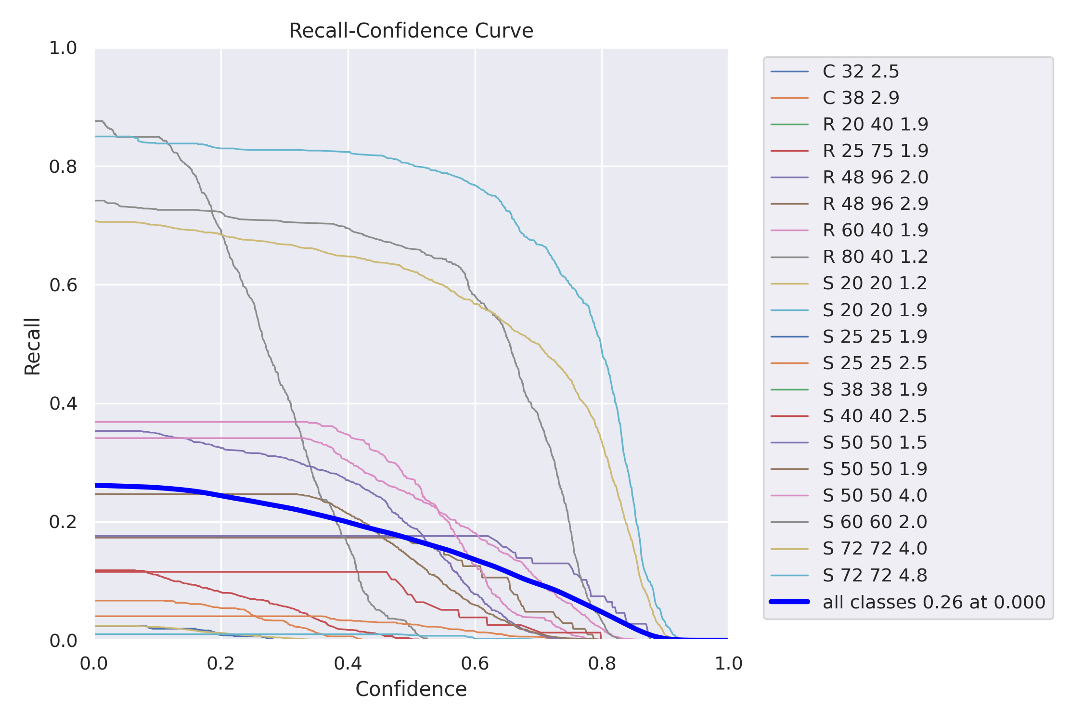
Best Model
YOLO V8 L gives the best Accuracy compare to other model
Notes:
Why Random Forest Regression is good?
A Random Forest Regression model is powerful and accurate. It usually performs great on many problems, including features with non-linear relationships
How is XGBoost different from random forest?
One of the most important differences between XG Boost and Random forest is that the XGBoost always gives more importance to functional space when reducing the cost of a model while Random Forest tries to give more preferences to hyperparameters to optimize the model..
n_estimators — the number of decision trees you will be running in the model

Slide 15
Model Deployment - Strategy
Using Streamlit we will Deployed the best Model
We Deployed model in such way that it should give Total pipe count and individual classes count

Slide 16
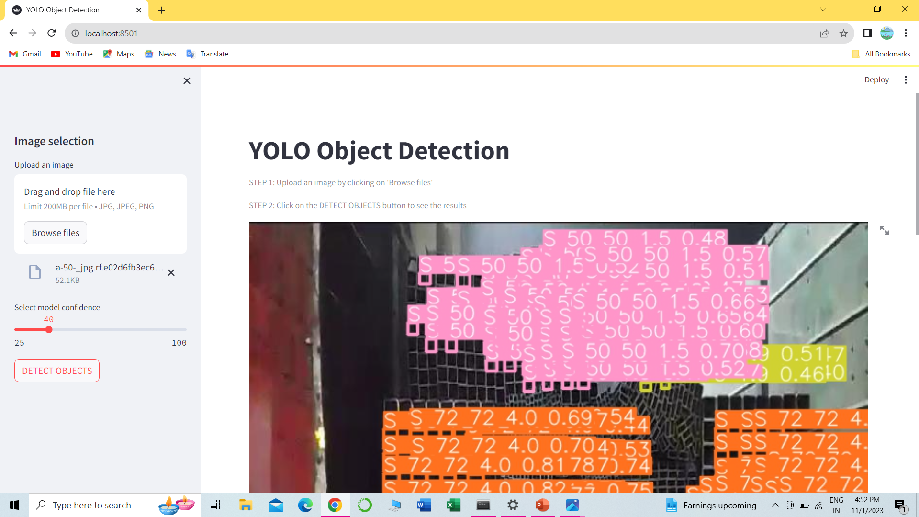
Screen shot of output

Slide 17
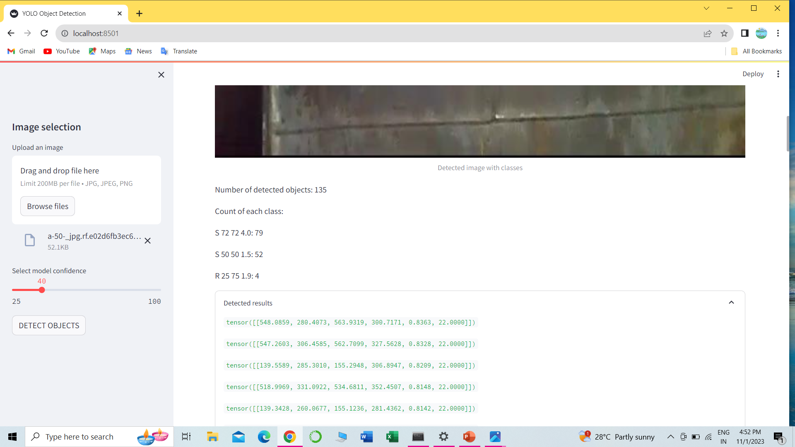

Slide 18

Challenges
Multi Class Classification Problem
Imbalance Classes
CUDA memory Issues
Not able to run more number of Epochs

Slide 19


Future Scopes
This Model will helps in Counting Pipes in easy way
It will save counting time
It will avoid human mad error
Speed and Accuracy
Less operational cost
Beter Inventory optimization

Slide 20


